Slide 1
Heading tag

Slide 2
Agenda
Heading tag
Sample output
Heading tag implementation

Slide 3
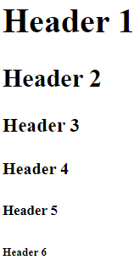
Heading tag
Heading Tag is used to set various levels of headers in HTML Pages.
There are 6 levels of Header tag.
Syntax
<h1> Heading here </h1>
<h2> Heading here </h2>
…
<h6> Heading here </h6>
It’s a good practice that as we go down the page, the heading level
should either decrease or remain constant.

Slide 4
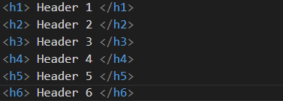
Sample output

Slide 5
Heading tag implementation
Let’s see implementation of Header tag.

Slide 6
Summary
Header tags are used to set various levels of heading in HTML page.
We have also see implementation of Heading tag.
DO NOT WRITE ANYTHING
HERE. LEAVE THIS SPACE FOR
WEBCAM

Slide 7
Thank You
Proprietary content. ©Great Learning. All Rights Reserved. Unauthorized use or distribution prohibited

